Slide 1
How to use this template
To insert text, click on the text box and start typing. Please note that copying and pasting text can change how the font looks. It is better to type directly onto the slide. Also note that fonts size 18 or larger work better for presentations than smaller font sizes.
When formatting charts/graphs, keep in mind readability for your audience. Labels should have high-contrast with their backgrounds. For example, if the label appears on top of red background color, white would have the highest contrast for that label. When possible, labels for data should have dark text on a white background.
The following slides are here for visual reference only. You may delete and edit as needed for your own presentation.
While this PowerPoint template is made to be accessible, please account for the following as you make edits:
Give each slide a unique title, including slides that you duplicate.
Include alternative, or alt text, descriptions to all images.
If you have any questions about how to use this template, please contact us at contact@umark.wisc.edu
This template is primarily to be used for data-driven presentations. Text and photographic presentation templates can be found at Brand & Visual Identity PowerPoint template page.
Before you start, check out our presentation best practices document.
This template has:
a title slide
a section header
two text slides (one-column or two-column)
an end slide
examples of charts and graphs
To select what version you would like, click on the drop-down menu beside “new slide” button in the top left corner. Select the slide you would like.

Slide 2
Week 1 Updates Shapiro
By Evan Johns

Slide 3
CosMx Data
Created program to convert R data into CSV files which can then be made into an Anndata object. Can use with Jupyter Notebooks
Completed for both Protein and RNA expression datasets
Working on loading and plott

Slide 4
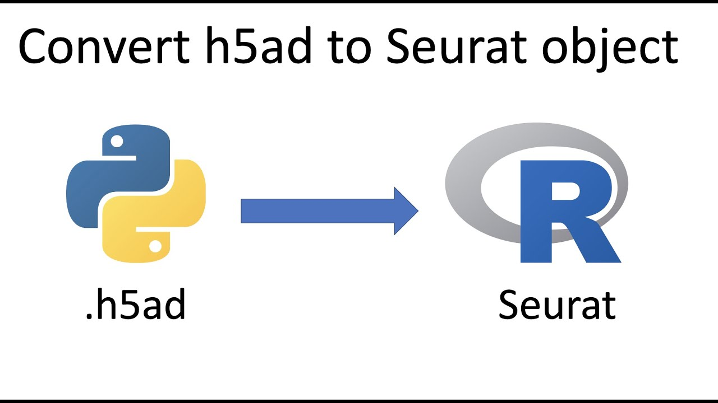
Training & Setup
Python
SquidPy Library plotting out data
Seurat
Single cell data set
Cell identification
AnnData and Seurat Object interconversion
Normal functions do not work for imaging data
Wrote R code to export data as CSV
Python code builds AnnData object

Slide 5
SquidPy Plotting and Packages

Slide 6
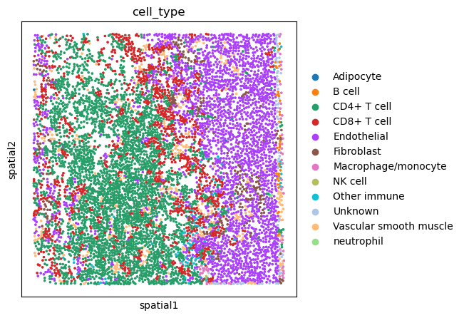
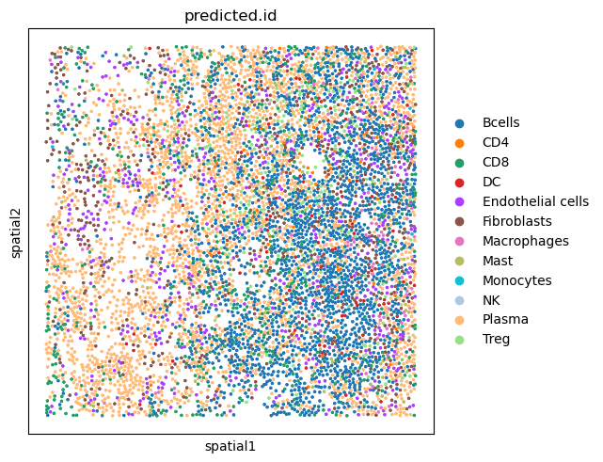
Question 1 – Mapping Protein Expression to mRNA expression
C_1_1_###
TMAA_###_1

Slide 7
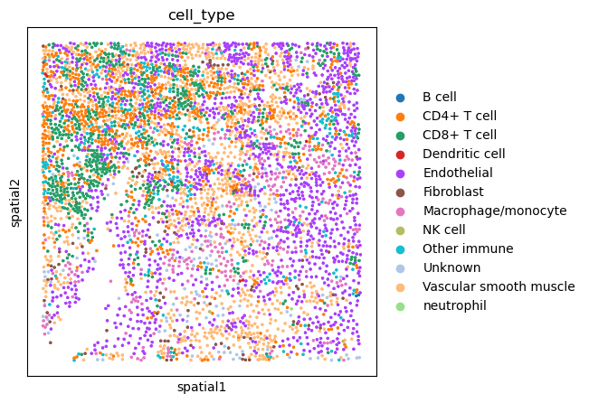
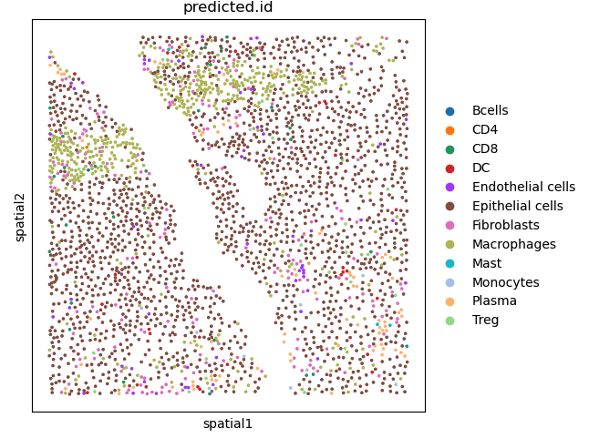
C_1_4_###
TMAA_###_4

Slide 8
Possible Reason for mismatch
Differing notation causing mismatch
Larger Z plane differential than expected
Issues loading data in the correct format
Manual edits to the CSV columns could have caused changes
Implications
Need to be able to align dataset in order to map protein to RNA. Otherwise would need to find accurate mRNA markers to identify PMNs.

Slide 9
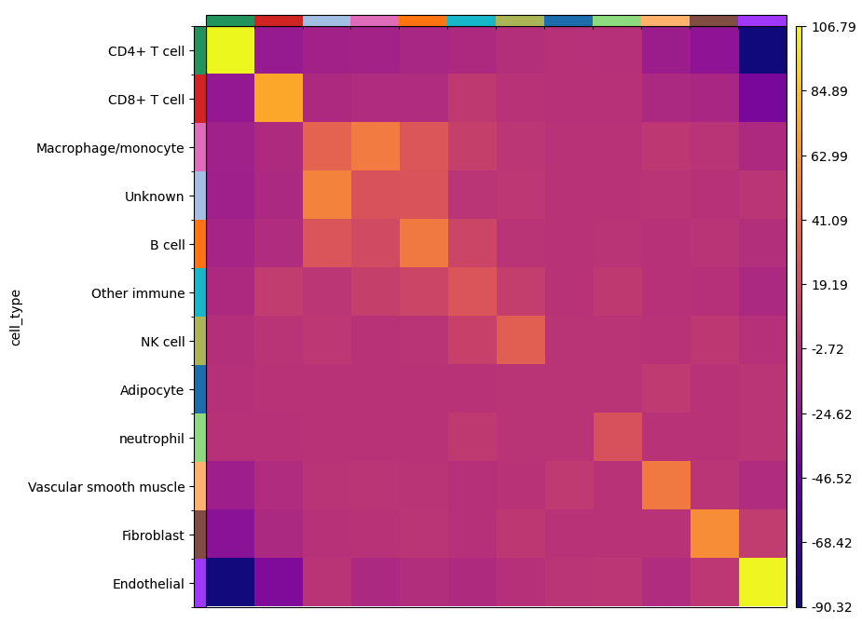
SquidPy Plotting Cell Clustering
C_1_4_###
Shows which cells like to clusters which with other cells
Most cells favor their own type
Did not notice much by the naked eye.
Still have bugs to fix, code only runs on about 1/3 of samples due to matrix errors.
Future Directions
Get numbers for all types and determine whether PMN spatial interaction with CD4 and CD8 cell are significant

Slide 10
mRNA Expression Cell identifcation

